Slide 1

Banking dataset Analysis and Prediction
Supervisor Name= Savita Seharawat
Submitted by = Manmeet Kaur (0776137)

Slide 2
Abstract
In today’s world, where huge amount of data is generated in every field of day-to-day activities, banking sector is one of them. The dataset is originally collected from Kaggle website. It contains customer information. This dataset contains 11163 records and 17 attribute. The dataset has two types of prediction either Yes or No. There are 16 input feature and 1 output. The facts are associated with the direct advertising and marketing campaigns of a Portuguese banking institution. The marketing campaigns have been primarily based on telephone calls. Often, a couple of contact to the identical client was required, in order to access if the product would be or now not subscribed by means of the customer or no longer. Term deposits are a major source of income for a bank. A term deposit is a coin’s investment held at a financial organization. Your money is invested for an agreed rate of interest over a hard and fast amount of time, or time period.. Hence, it's far important to become aware of the customers maximum probable to convert beforehand so they can be mainly target via calls. The data is related to direct marketing campaigns (phone calls) of a Portuguese banking organization.

Slide 3
Research Question
Question 1. To cumulate that how many customers taking loan according to their education level?
Question2. How many customers taking house loan from the bank ?
Question 3. Use Box Plot to compare the age of customers for the top 5 of the most common employment forms .
Question 4. To calculate which month customer deposit maximum amount of money?

Slide 4
Data Preprocessing

Slide 5
Data Preprocessing
Merging Datasets
Firstly, I did import the libraries and then loading the dataset and show top 5 records and check shape and null values after that show the datatype and unique values and then statistical summary.
I apply label encoder method to change category to numerical and then drop some columns. Further that, I did data visualization, train and test split method, modeling then I find out optimal model and make confusion matrix, ROC Curve and at last Classification Report .
After implementing, the result acquired become best.

Slide 6
Exploratory Data Analysis(EDA)

Slide 7
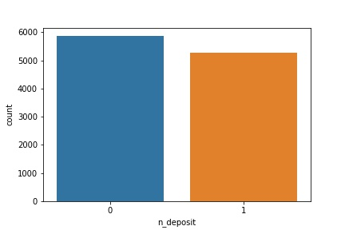
Distrubution of target variable
I can see the total number of count of the deposit (1) means has the client subscribed a term deposit or(0) not subscribed
The total number of count 0 is5873 and count 1 is 5289.

Slide 8
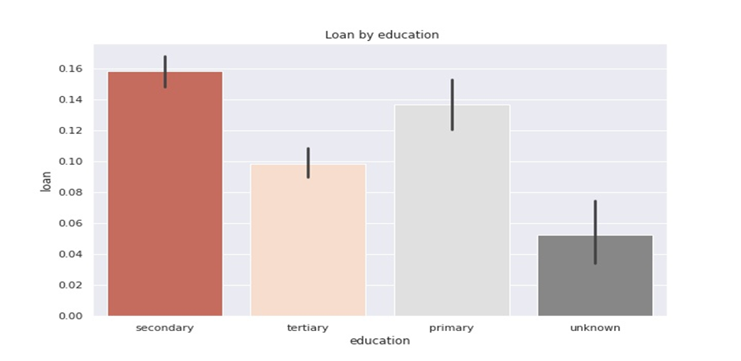
Question 1. To cumulate that how many customers taking loan according to their education level?
The person who takes the secondary education has taking the highest number of loans. Primary education level is 2nd highest number.

Slide 9
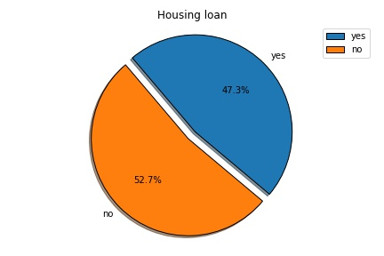
Question 2 : How many customers taking house loan from the bank ?
In this pie chart, we can see that 47.3% customers take less house loan and 52.7% took more house loan.

Slide 10
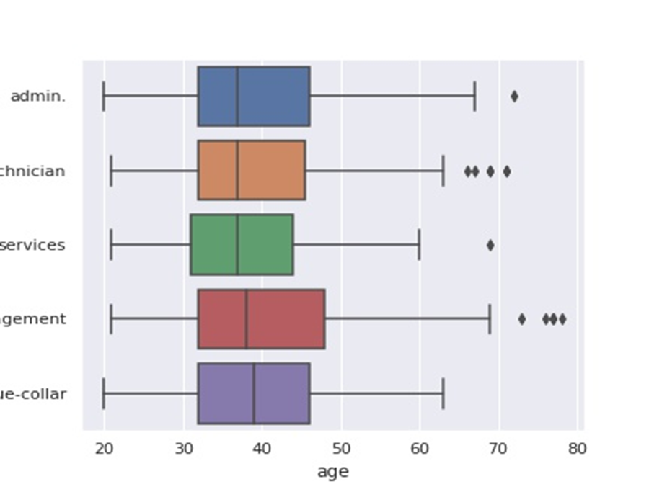
Question 3 Use Box Plot to compare the age of customers for the top 5 of the most common employment forms
The plot shows that among the top-5 client categories, the most senior customers represent the management, and the largest number of outliers is among the management and technician

Slide 11
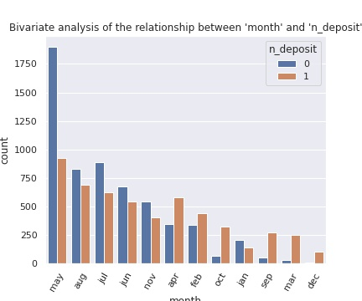
Question4 To calculate which month customer deposit maximum amount of money?
May got a slightly more subscribers than the other months. The subscription average is almost the same in December and January. These months were got the very fewest subscriptions. One possible reason could be the fact the people go for holidays. (In the Americas people are used to take holidays in this period of the year).

Slide 12
Correlation
It is a square and symmetric matrix in every row represents a variable, and all the columns represent the same variables as rows, consequently the quantity of rows same wide variety of columns. All diagonal factors are 1.
Duration(0.45) is highly and more positive corelated with n1_deposit.
"campaign" is the most negative correlated feature to n1_deposit
"n_jobs" and "n_material" and "n_education"are positive correlated to each other.
No strong correlation has been observed between any of the variables.

Slide 13
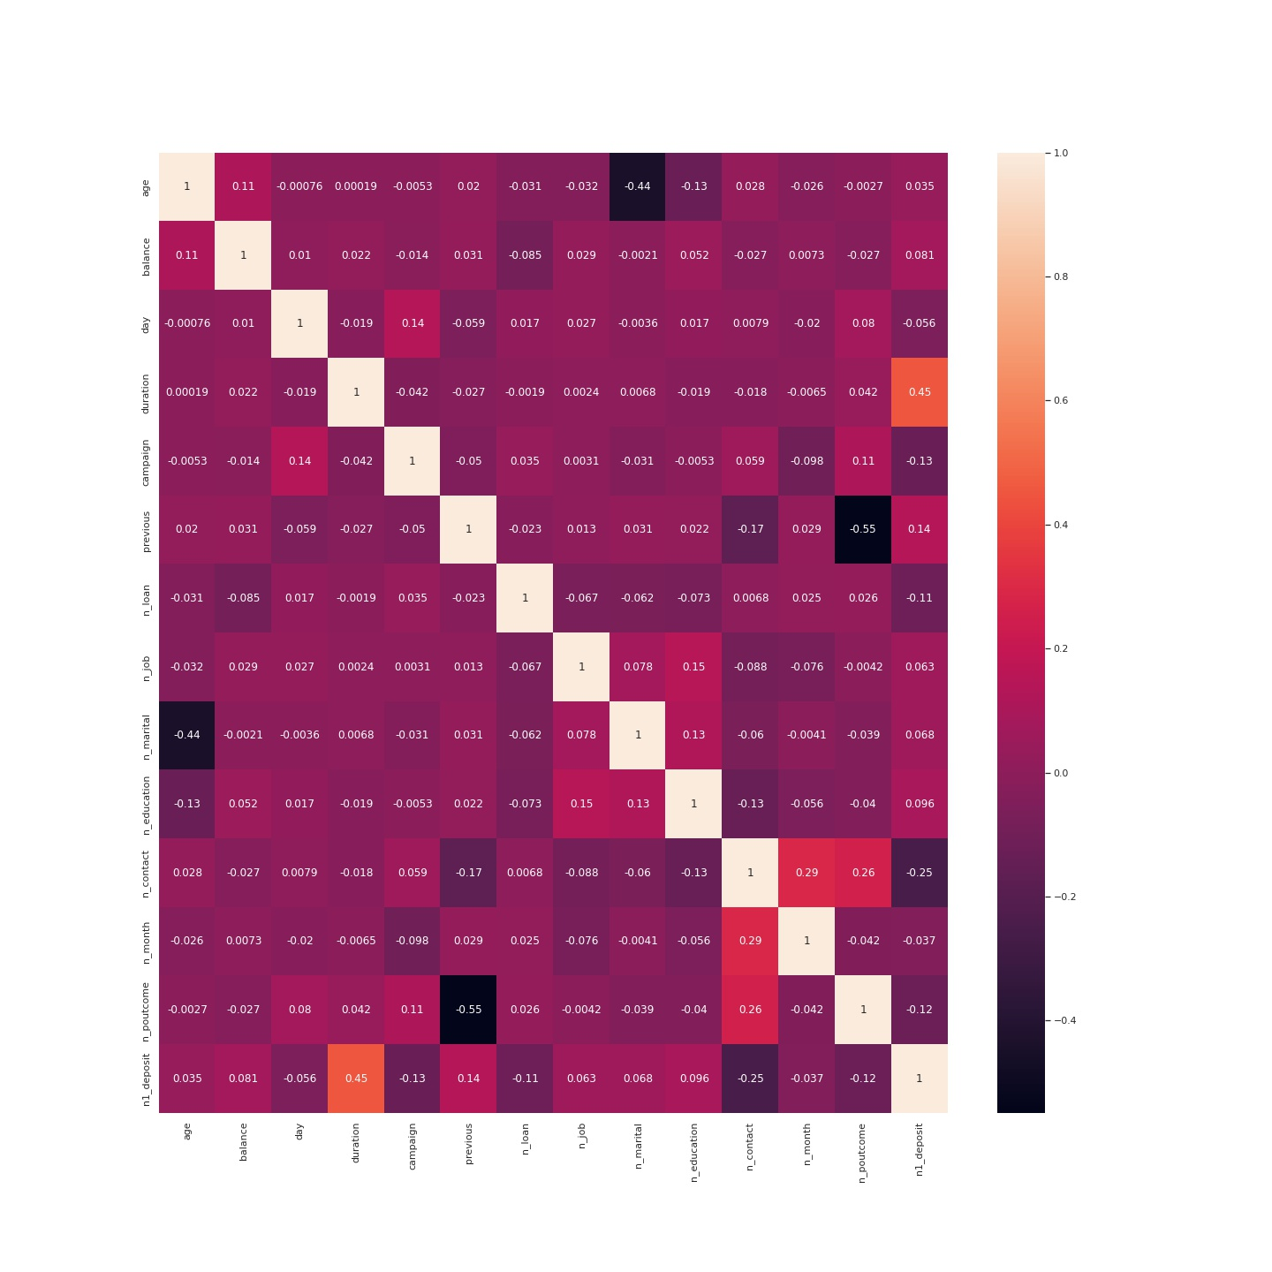
Correlation between target variable and the other attribute

Slide 14
Experimental Design

Slide 15
Treatment for imbalance
To balance the target variable in the dataset , I used the Minority Oversampling approach.
A huge number of humans contacted did now not want to subscribe service offered by the financial institution. Just the 3714 stated yes. This excessive difference shows an imbalanced class trouble. This issue might be dealt with the use of oversampling.

Slide 16
Model Implementation and Evaluation

Slide 17
In the modelling part there are four methods Logistic Regression, KNN, Naive Bayes, random forest that I have applied on my dataset.
Logistic Regression: This model is supervised learning of classification algorithm. It is used to check the probability of target variable like team is winning or not.
KNN: The KNN stands for “K-Nearest Neighbour”. It is a supervised machine learning algorithm. It is used to check the similarity of cat and dog. The algorithm can be used to solve both classification and regression problem statements. We create a one image of cat and dog then we differentiate either it is cat or dog.
Naive Bayes: Naive Bayes is a classification technique based on Bayes' Theorem with strong an assumption of independence among predictors. It is also called network model.
Random Forest: It is a Supervised Machine Learning Algorithm that is used commonly in Classification and Regression problems. It builds multiple decision trees on different samples and takes the majority for classification and average in case of regression.

Slide 18
Accuracy Matrix
Column1 | Model | Train_test_split
0 | Logistic Regression | 77.69483428
1 | KNN | 76.29143028
2 | Naive Bayes | 75.18662287
3 | Random Forest | 81.45715139

Slide 19
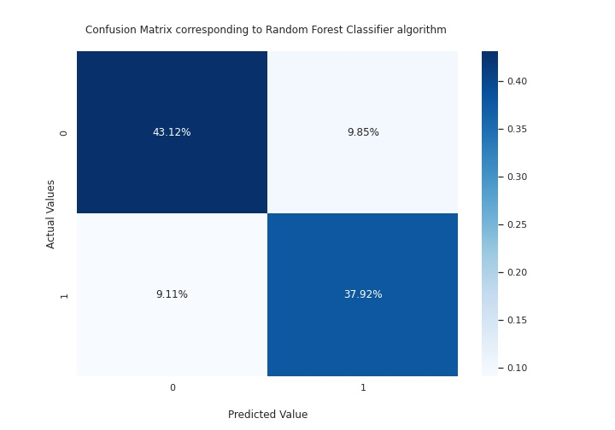
Confusion matrix corresponding to the optimal model(Random forest classifier)
It is a tabular summary of the number of correct and incorrect predictions made by a classifier. The actual values correspond to 0 and predicted is 0 is 43.12% is right and the actual value correspond to 0 and predicted correspond to 1 is false (9.85%)

Slide 20
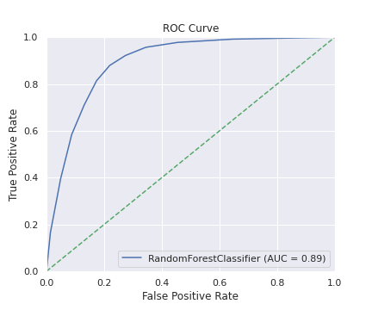
ROC curve corresponding of the optimal model(RFC)
Receiver operating characteristic - it is metric to evaluate classifier output quality. The AUC is 0.89. The area under curve is right

Slide 21
Classification Report
Precision = how many predicted values is right is 0.82
Recall= how many actual values is right is 0.83
F1 score = It is positive class in binary classification or weighted average of the f1scores of each class for the multiclass task.
Support = It is occurrence class
Column1 | precision | recall | f1 score | support
0 | 0.82 | 0.83 | 0.83 | 1774
1 | 0.81 | 0.81 | 0.81 | 1575

Slide 22
Conclusion

Slide 23
In banking dataset big quantity of statistics is generated continuously and this information can be used to extract significant records. The bank dataset is used for term deposit prediction. It contains purchaser information. The dataset has styles of prediction both Yes or No. There are 16 input function and 1 output. After imposing (Supervised set of rules) Random Forest used for classification reason, the algorithm offers 81% accuracy for dataset by means of measuring accuracy, precision, recall, f1-score, support. The main goal of this work to predict whether a customer will subscribe to a time period deposit. The paintings on this paper have used financial institution dataset from Kaggle internet site to make classification. After implementing, the result acquired become best.

Slide 24
Recommendations
This dataset is all about the banking in Portuguese banking institution. If someone want to make project on this dataset. This is the best dataset because it give all the information like customers performance, clients details, loans, campaign.

Slide 25

Thank You

